Slide 1
Data Structure in Python

Slide 2
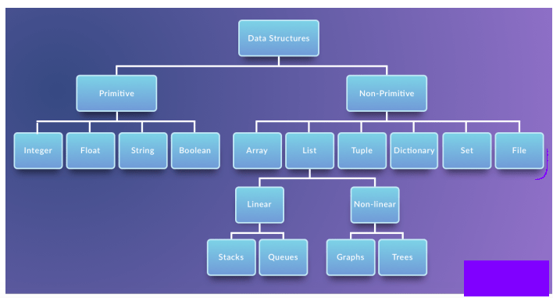

Slide 3
Array
used to store collection of homogeneous items.
In Python Instead of array we refer list.
In Python, arrays are supported by the array module and need to be imported before you start inititalizing and using them. The elements stored in an array are constrained in their data type.
array(data type, value list)
import array as arr
a = arr.array("I",[3,6,9])

Slide 4
List
Lists in Python are used to store collection of heterogeneous items.
List is a collection which is ordered and changeable. Allows duplicate members.
Ex:
L1 = ["John", 102, "USA"]
L2 = [1, 2, 3, 4, 5, 6]
L3 = [1, "Ryan"]

Slide 5
Access Items:
You access the list items by referring to the index number:
L1 = ["John", 102, "USA"]
print(L1[0])

Slide 6
List indexing:

Slide 7
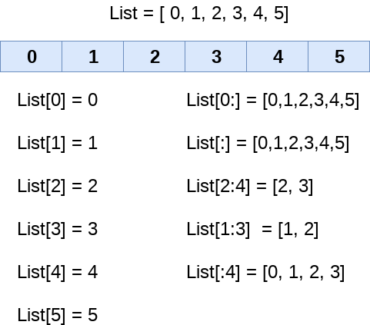
List[::-1]= [5,4,3,2,1,0]

Slide 8
List Slicing:
Listobj[startindex:endindex]
Ex: L2 = [1, 2, 3, 4, 5, 6]
print(L2[1:3])
List Slicing with step size:
L2 = [1, 2, 3, 4, 5, 6]
print(L2[0:5:2])
Output: [1,3,5]

Slide 9
if Item Exists
To determine if a specified item is present in a list use the in keyword:
Ex:
fruitlist = ["apple", "banana", "cherry"]
if "apple" in fruitlist:
print("Yes, 'apple' is in the fruits list")

Slide 10
Important point :
The concatenation (+) and repetition (*) operator work in the same way as they were working with the strings.
Ex:-
l1 = [1, 2, 3, 4]
l2 = [5, 6, 7, 8]
l1*2 = [1, 2, 3, 4, 1, 2, 3, 4]
l1+l2 = [1, 2, 3, 4, 5, 6, 7, 8]

Slide 11
Inbuilt functions for List:
Len()
Max()
Min()
Sum()
cmp(list1, list2)

Slide 12
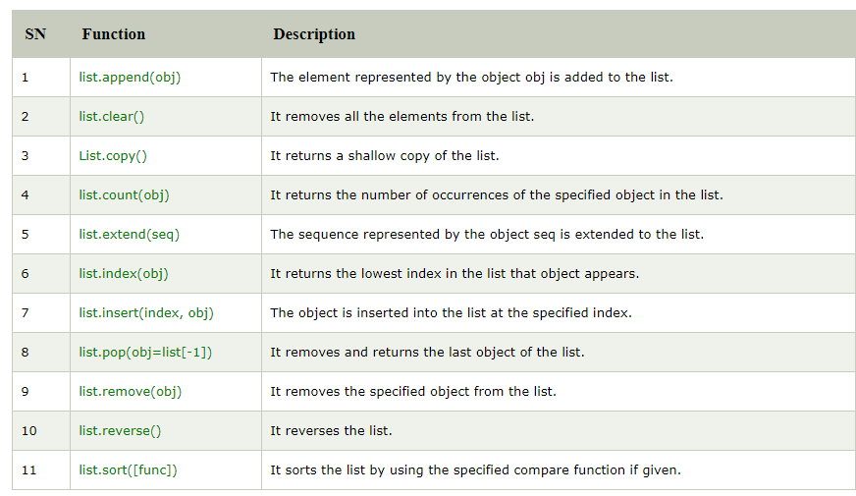
In built List methods:

Slide 13
tuple
tuple in Python are used to store collection of heterogeneous items.
Use ()
tuple is immutable
We can use tuple as a key in dictionary
T1=(1,2.4,”hello”)
T1[0]=1
T1[1]=2.4
T3[2]=hello

Slide 14
Packing and Unpacking
A tuple can also be created without using parentheses. This is known as tuple packing.
e.g:
my_tuple = 3, 4.6, “hello“
print(my_tuple)
tuple unpacking is also possible
a, b, c = my_tuple
Print(a)

Slide 15
Index and slicing
>>>my_tuple = ('p','r','o','g','r','a','m','i','z')
# elements 2nd to 4th
# Output: ('r', 'o', 'g')
>>>print(my_tuple[1:4])
# elements beginning to 2nd
# Output: ('p', 'r')
>>>print(my_tuple[:-7])
# elements 8th to end
# Output: ('i', 'z')
>>>print(my_tuple[7:])
# elements beginning to end
# Output: ('p', 'r', 'o', 'g', 'r', 'a', 'm', 'i', 'z')
>>>print(my_tuple[:])

Slide 16
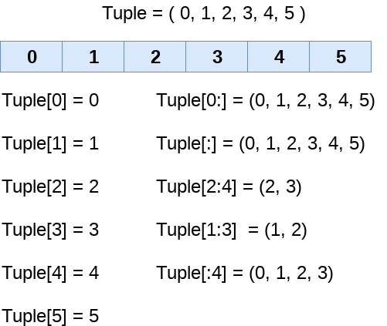

Slide 17
We can use + operator to combine two tuples. This is also called concatenation.
We can also repeat the elements in a tuple for a given number of times using the * operator.
print((1, 2, 3) + (4, 5, 6))
print((“hello",) * 3)

Slide 18
Deleting a Tuple
T=(1,2)
del T
Length of a Tuple:
T=(1,2,3)
len(T)
Converting list to a Tuple using tuple() function
List=[1,2,3]
tuple(list)

Slide 19
cmp(tuple1, tuple2) | It compares two tuples and returns true if tuple1 is greater than tuple2 otherwise false.
len(tuple) | It calculates the length of the tuple.
max(tuple) | It returns the maximum element of the tuple.
min(tuple) | It returns the minimum element of the tuple.
tuple(seq) | It converts the specified sequence to the tuple.

Slide 20
Dictionary
Collection of key-value pairs where the keys are the immutable.
dictionary is a mutable ,its values can be updated by using the specific keys.
Syntax:
dictionaryName={“key1”:value1,”key2”:value2,…}
Ex: employee={"name":"kum","age":34,"salary":25000}

Slide 21
Accessing the dictionary values
By using keys
employee={"name":"kum","age":34,"salary":25000}
print(employee[“Name”])
By using get(keys)
Ex:
get(“name”)

Slide 22
Updating dictionary
dictionary is a mutable so, its values can be updated by using the specific keys.
Ex:
employee={"name":"kum","age":34,"salary":25000}
employee[“salary”]=35000

Slide 23
How to take input for dictionary
mydict={}
print("enter key")
key=input()
print("enter value")
value=input()
mydict[key]=value

Slide 24
Dictionary Methods :
Method name | Description
_x000b_dic.clear() | It is used to delete all the items of the dictionary.
dict.copy() | It returns a shallow copy of the dictionary.
dict.items() | It returns all the key-value pairs as a tuple.
dict.keys() | It returns all the keys of the dictionary.
dict.values() | It returns all the values of the dictionary.

Slide 25
random numbers and list of random numbers
random.random()
This function generates a random float number between 0.0 and 1.0.
random.randint()
This function returns a random integer between the specified integers.
Ex:
print(random.randint(0,9))

Slide 26
randrange(beg, end, step) :- This function is also used to generate random number but within a range specified in its arguments.

Slide 27
Files and exceptions
Syntax: file object = open(<file-name>, <access-mode>)
The new file can be created by using one of the following access modes with the function open().
x: it creates a new file with the specified name. It causes an error a file exists with the same name.
a: It creates a new file with the specified name if no such file exists. It appends the content to the file if the file already exists with the specified name.
w: It creates a new file with the specified name if no such file exists. It overwrites the existing file.

Slide 28
"r" - Read - Default value. Opens a file for reading, error if the file does not exist
"a" - Append - Opens a file for appending, creates the file if it does not exist
"w" - Write - Opens a file for writing, creates the file if it does not exist
"x" - Create - Creates the specified file, returns an error if the file exists

Slide 29
The read functions contains different methods, read(),readline() and readlines()
read() #return one big string
readline #return one line at a time
readlines #returns a list of lines

Slide 30
write(): Used to write a fixed sequence of characters to a file
writelines() #writelines can write a list of strings.
Append ()
The append function is used to append to the file instead of overwriting it. To append to an existing file, simply open the file in append mode ("a")
Close()
When you’re done with a file, use close() to close it and free up any system resources taken up by the open file

